Slide 1
Housing Price and Weekly Rent Prediction
Abdul Sattar Mohammed 45830541
Jan Arvin Lapuz 45758891
Jerome Roosan 45999589
Le Van Nguyen 45817006

Slide 2
Table of contents
Overview
Motivations
Data collection
Project objectives
Data processing
Rent price analysis
Data exploration
Decision tree regression
Linear regression
Analysis conclusion
Sales price analysis
Data exploration
Decision tree regression
Linear regression
Analysis conclusion
Conclusion
Final thoughts
Further extension

Slide 3

Overview

Slide 4

Motivations
Sydney house prices are increasing ↗️↗️
But why ?
Population increase ?
Infrastructures are improved?
Economy develops ?
Or because of these ?

Slide 5
Project objectives
Look house sales and weekly rent at each of LGA of NSW region
For population, we collect demographic characteristics
For infrastructure, we collect transportation data
For economy development, we collect nighttime lights
01 | How do demographic characteristics, transportation modes and nighttime lights affect house prices and weekly rent?
02 | What are the best features that can help to predict house price and weekly rent?
03 | Can we use those features to predict current house sales and weekly rent?

Slide 6
Data collection
House sales and weekly rents
Quarterly reports of sales and weekly rent of each LGA for 2017 and 2019.
From Department of Communities and Justice
Link facs.nsw.gov.au
Transportation data
Transportation points: longitude and latitude locations of bus stops and train stations
From NSW Open Data API for Public Transport Timetables
Link opendata.transport.nsw.gov.au
1
3
2
Nighttime lights
Graphic file capturing nighttime lights
From Earth Observation Group at the National Oceanic and Athmospheric Administration who manages the satellite that captures and processes the lights at night for the entire surface of Earth
Link ngdc.noaa.gov
4
Census data
Population information from 2016 for each LGA: age group, income brackets and education attainment
From Australian Bureau of Statistics' Census General Data Community Profile Data Packs
Link datapacks.censusdata.abs.gov.au

Slide 7
Data processing
House sales and weekly rent:
We focus on 2017 data for the analysis
Match LGA code with 126 LGAs in the report
Extract into csv files containing
Overall means and median
Means and median by dwelling types
Means and median by number of bedroom (for weekly rent)
Nighttime lights:
The collected files are TIFF images as a matrix containing the average luminosity on each pixel which is approximately about 500 m2
We collect 2017 (closet to census data) and 2019 (latest data)
Overlay the images over NSW shapefile compute summary statistics of the pixel values that fall inside each LGA's boundaries
We generated sum of total values and divide it by land area to get mean per land area

Slide 8
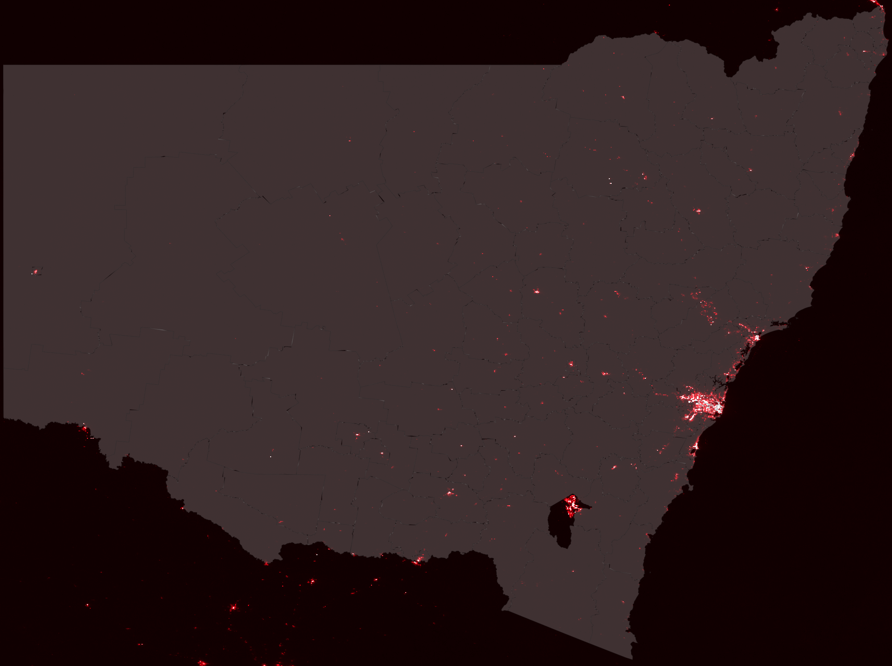
Nighttime lights points are overlaid over nsw shapefile

Slide 9
Data processing
Transportation:
We collect transportation data containing bus stops, train stations and other means with their geographic coordinates.
Like nighttime lights data, we overlay the coordinates into NSW shapefile and count the number of stops or stations within each LGA boundary.
The generated data are the counts of each kind of stops by each LGA code
We analyse the data based on 3 groups: bus stops, train stations and all transportation
Census:
The census data pack contains an enormous amount of data with a total more 15,500 different LGA characteristics.
We trimmed them down by selecting:
Age distribution
Household size
Weekly income
Educational attainment
Country of origin
Marital status

Slide 10
Rent analysis

Slide 11
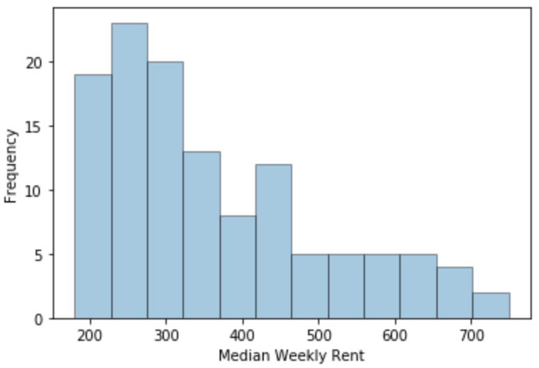
Data exploration
Median Weekly Rent Data (in AUD)
Count 121.00
Mean 363.25
Min 180.00
50% 320.00
Max 749.00

Slide 12
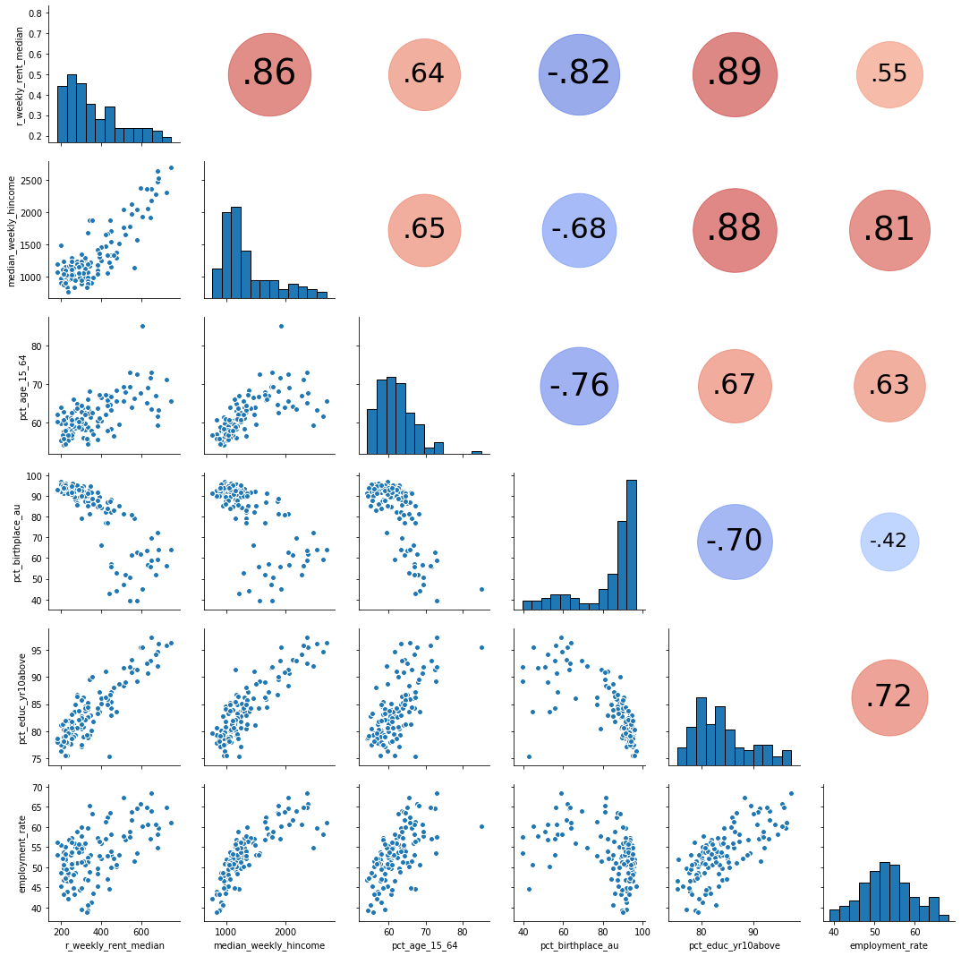
Data exploration
Median Weekly Rent Data (in AUD)
Weekly HH Income
% 15 to 64 year old
% Born in Australia
% Finished Year 10 and Above
Employment Rate

Slide 13
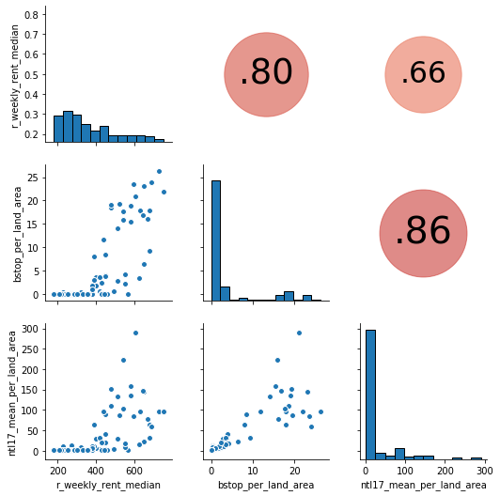
Data exploration
Median Weekly Rent Data (in AUD)
Bus Stop per Land Area
Nighttime Lights per Land Area

Slide 14
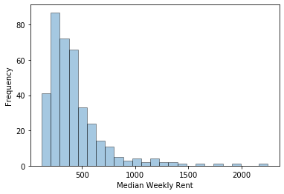
Data exploration
Median Weekly Rent Data by Bedroom (in AUD)
Count 375.00
Mean 431.85
Min 120.00
50% 360.00
Max 2,250.00

Slide 15
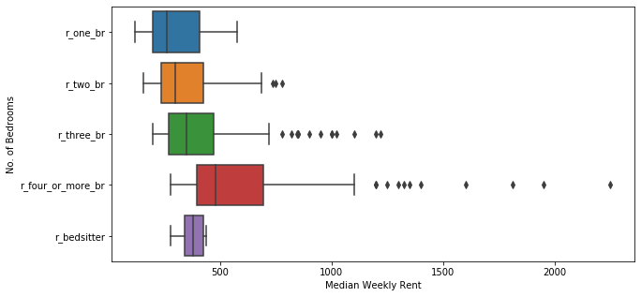
Data exploration
Weekly rent is proportional to the number of bedrooms. Median weekly rent for bedsitters is greater than a three bedroom property.

Slide 16
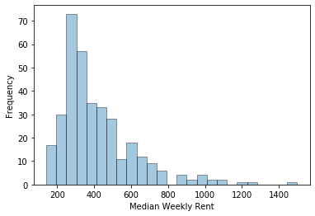
Data exploration
Median Weekly Rent Data by Dwelling Type (in AUD)
Count 346.00
Mean 415.60
Min 140.00
50% 352.50
Max 1,500.00

Slide 17
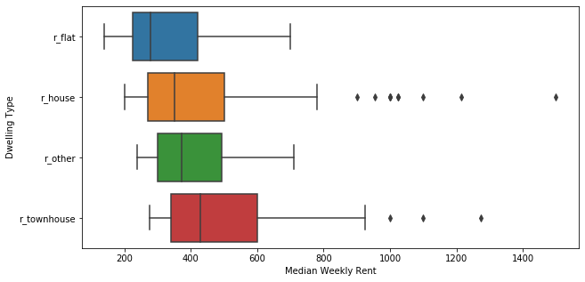
Data exploration
Weekly rent is the most expensive for townhouses, and cheapest for flats.

Slide 18
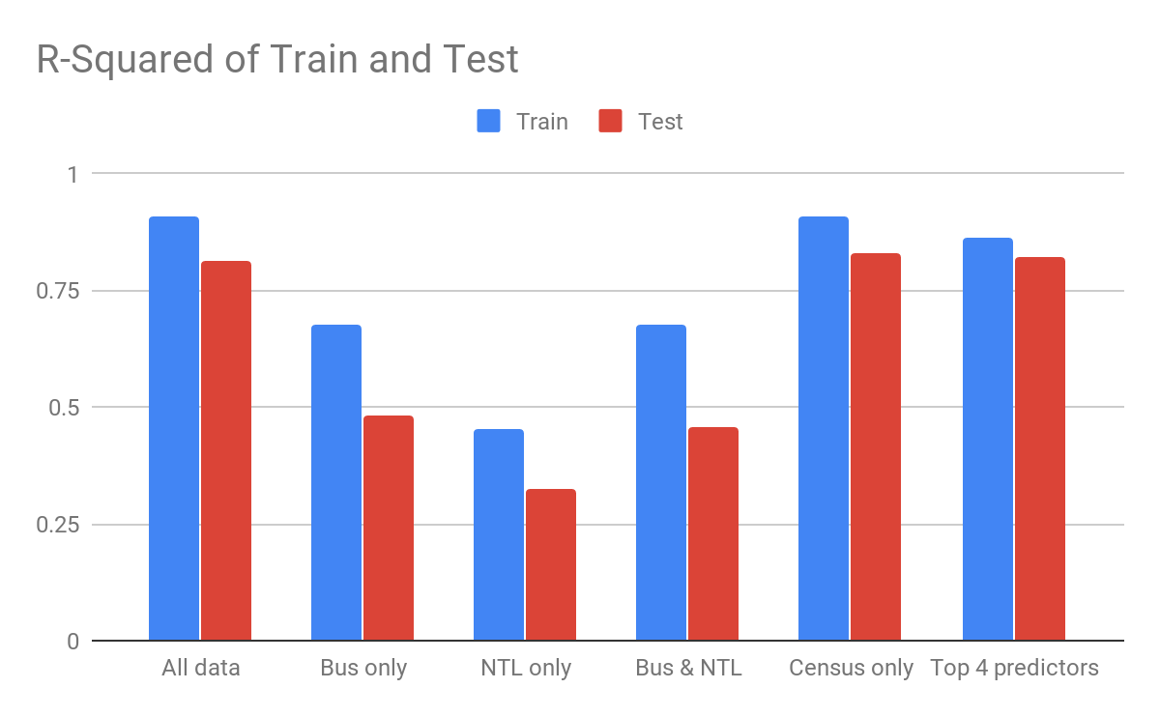
Linear modeling - overall - Adjusted R2

Slide 19
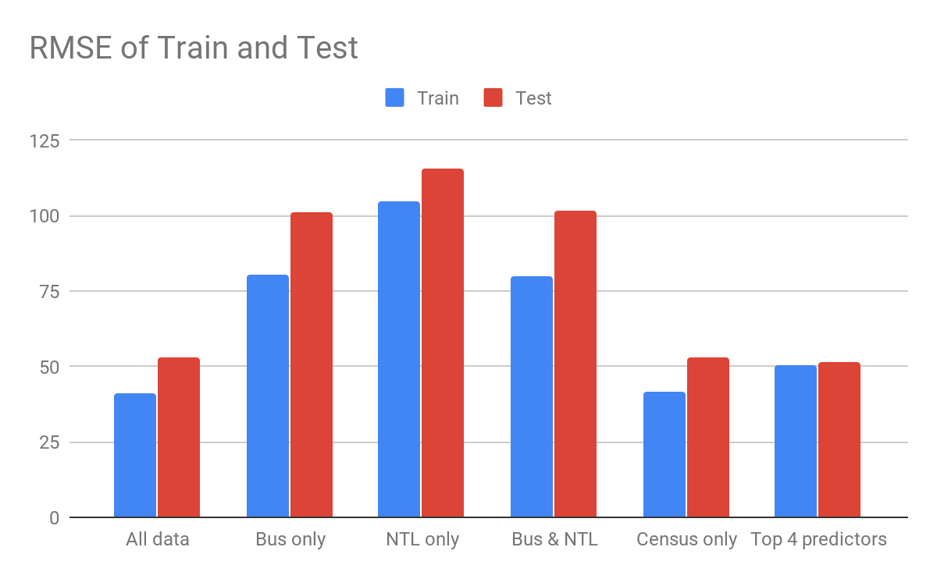
Linear modeling - overall - RMSE

Slide 20
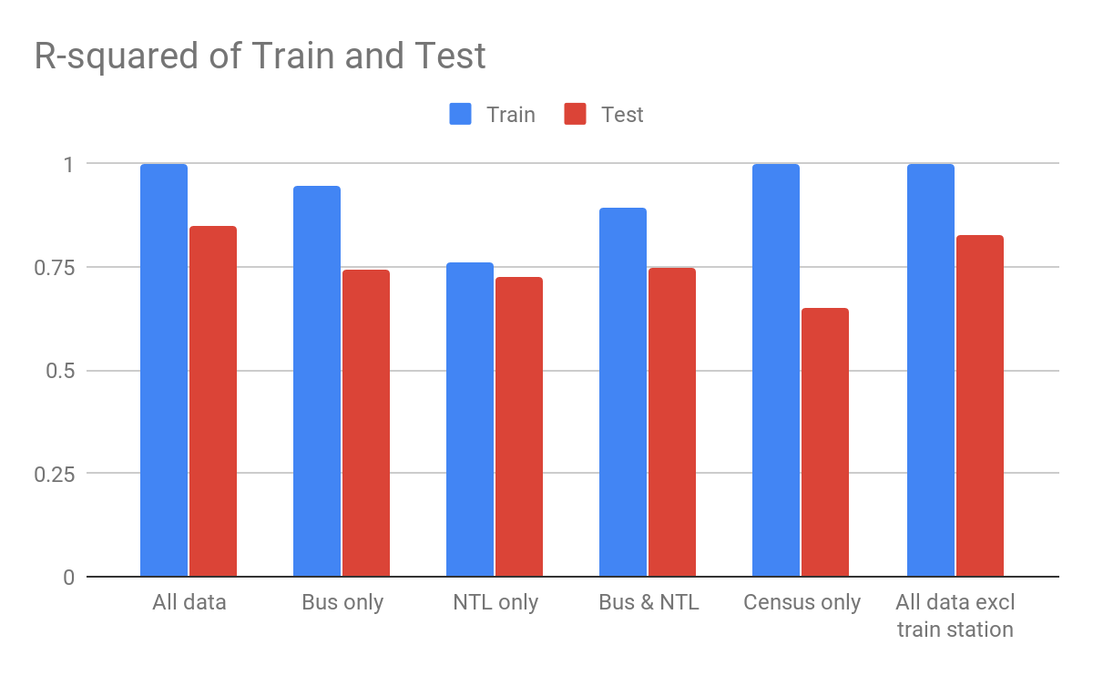
Decision tree modeling - overall - R2

Slide 21
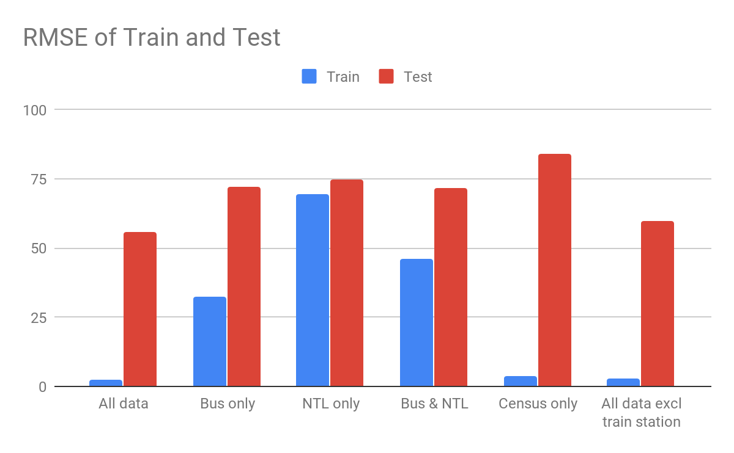
Decision tree modeling - overall - RMSE

Slide 22
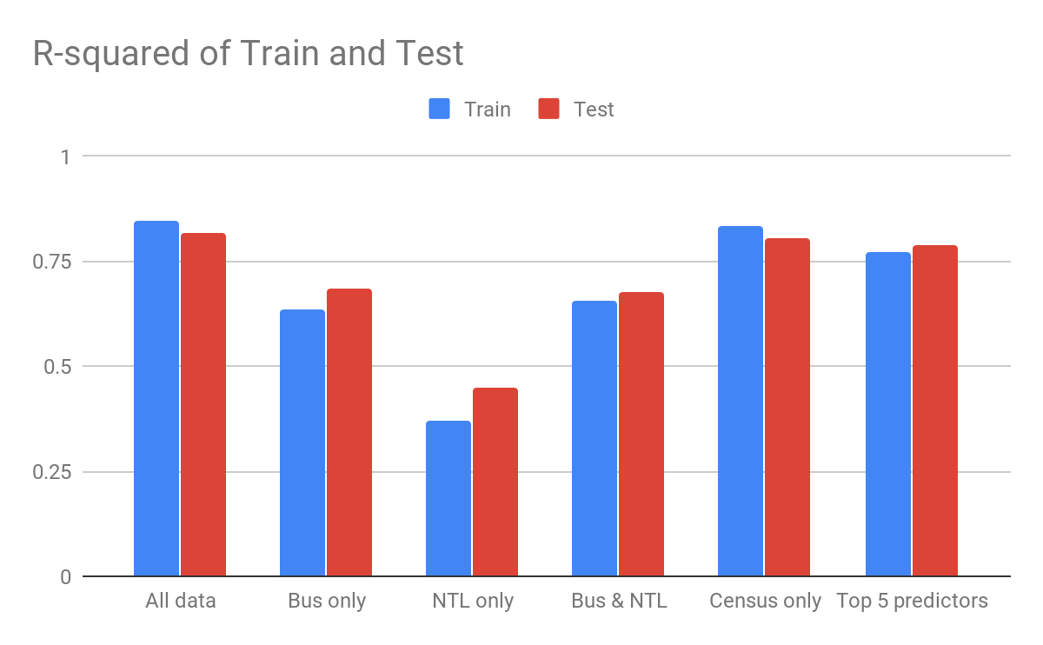
Linear modeling - by dwelling type - R2

Slide 23
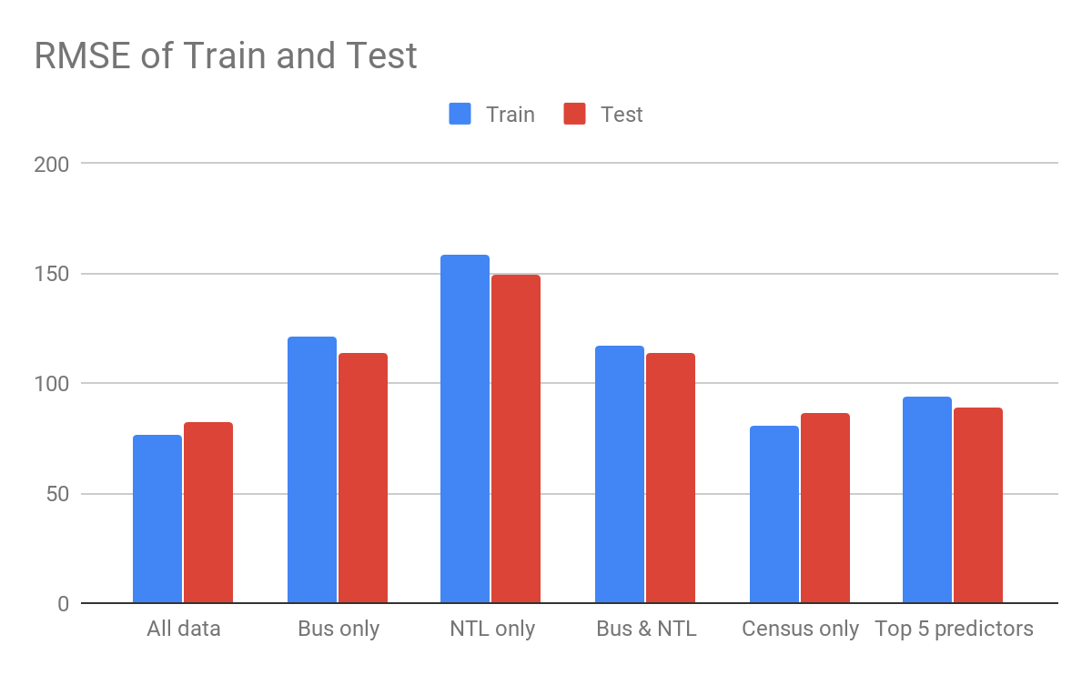
Linear modeling - by dwelling type - RMSE

Slide 24
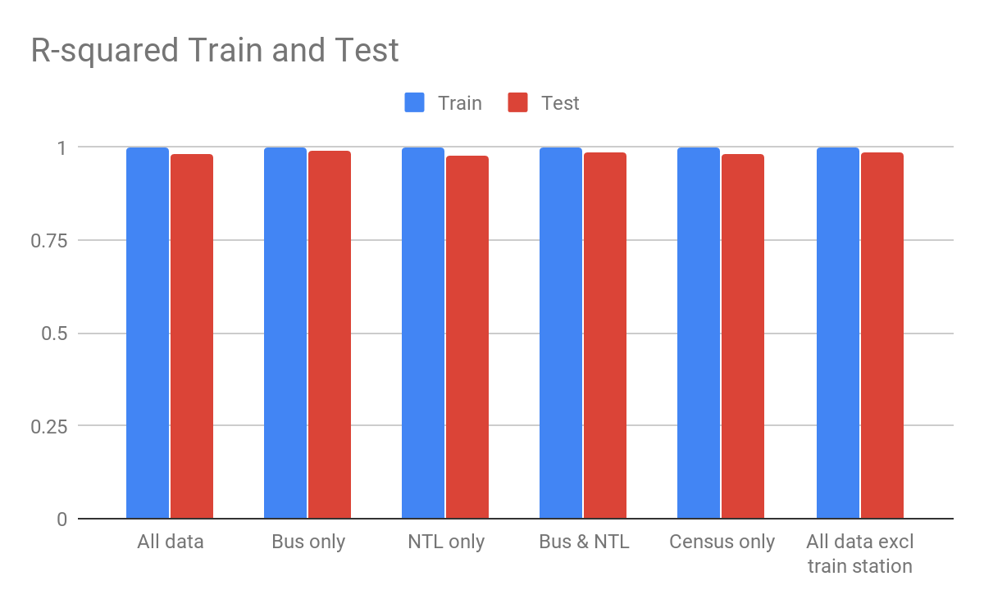
Decision tree modeling - by dwelling type - R2

Slide 25
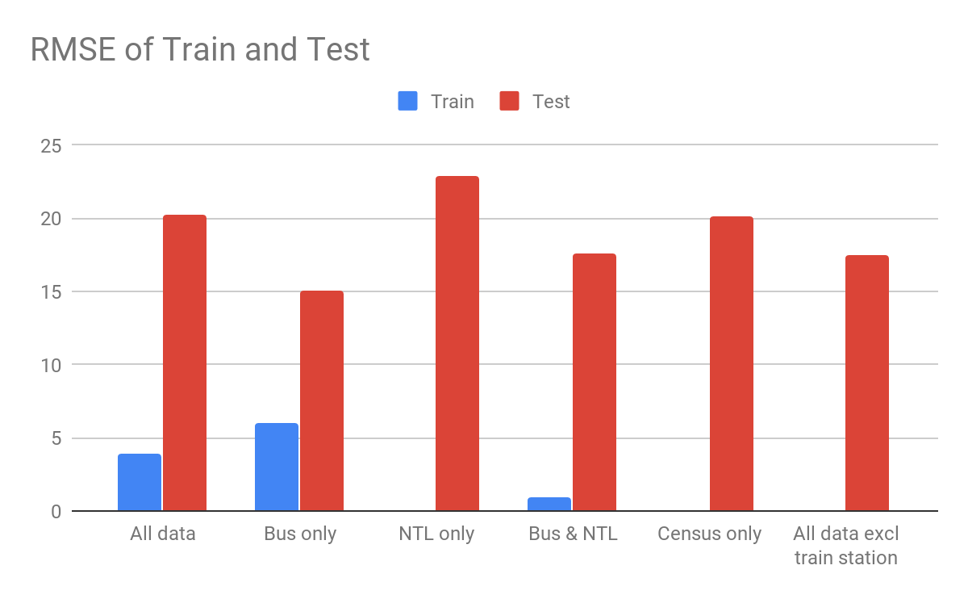
Decision tree modeling - by dwelling type - RMSE

Slide 26
Rent analysis conclusion
The most of the important predictors comes from the census and transportation data
Decision tree models perform better purely in R2 while RMSE tells another story. The model could be overfitted

Slide 27
Sales data

Slide 28
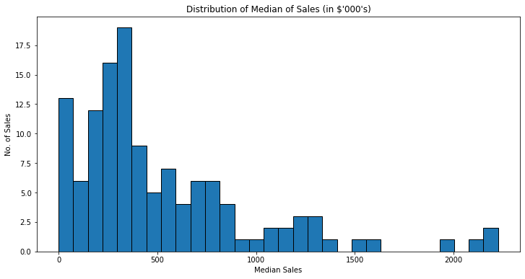
Data exploration - Overall
Median House Sales Data (in AUD)
Count 111.00
Mean 581,000.83
Min 0.00
50% 420,000.00
Max 2,225,000.00

Slide 29
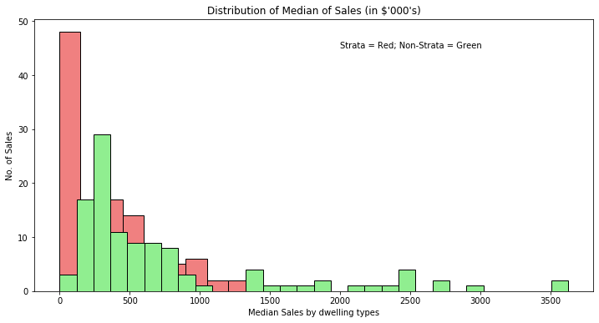
Data exploration - By Dwelling type
Median House Sales Data by Dwelling type (in AUD)
 | Strata | Non-Strata
Count | 111 | 111
Mean | 332,000 | 758,000
Min | 0 | 0
50% | 285,000 | 430,000
Max | 1,500,000 | 3,625,000

Slide 30
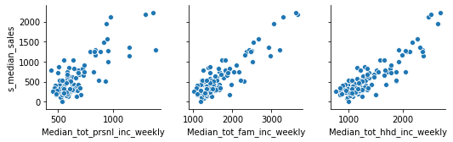
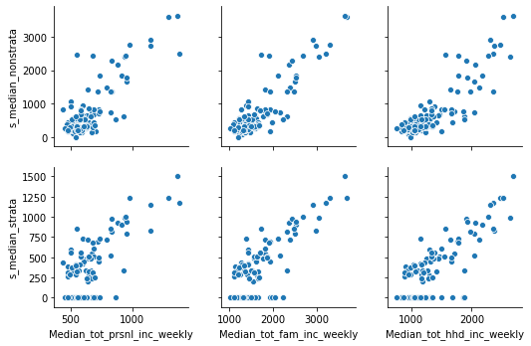
Data exploration
Income Data - Overall Income Data - By Dwelling type

Slide 31
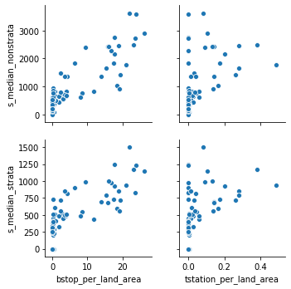
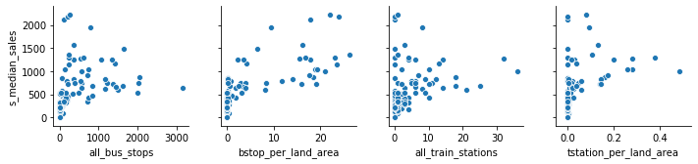
Data exploration
All transports - Overall All transports - By Dwelling type

Slide 32
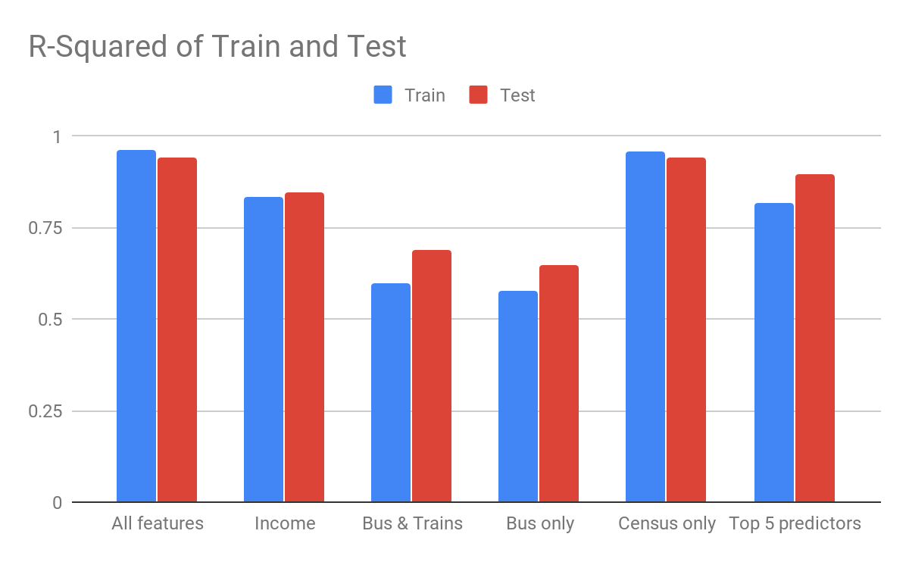
Linear modeling - overall - R2

Slide 33
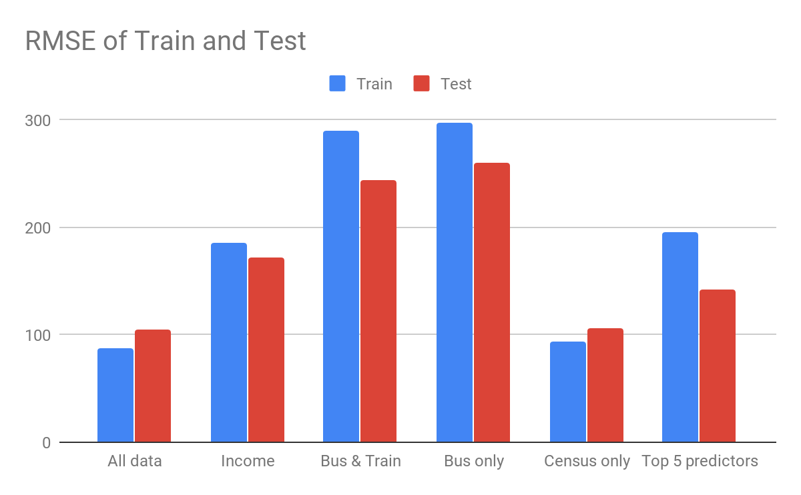
Linear modeling - overall - RMSE

Slide 34
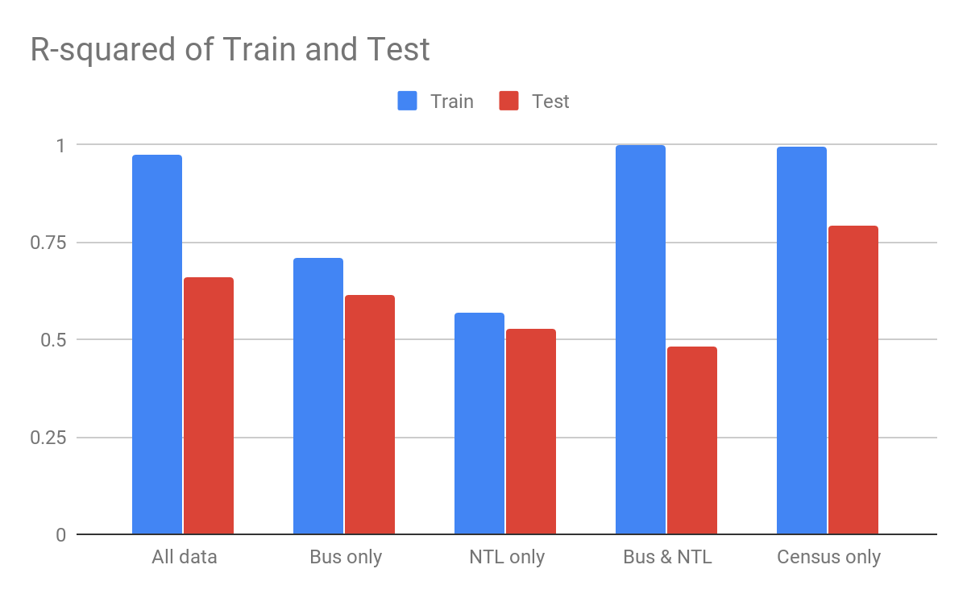
Decision tree modeling - overall - R2

Slide 35
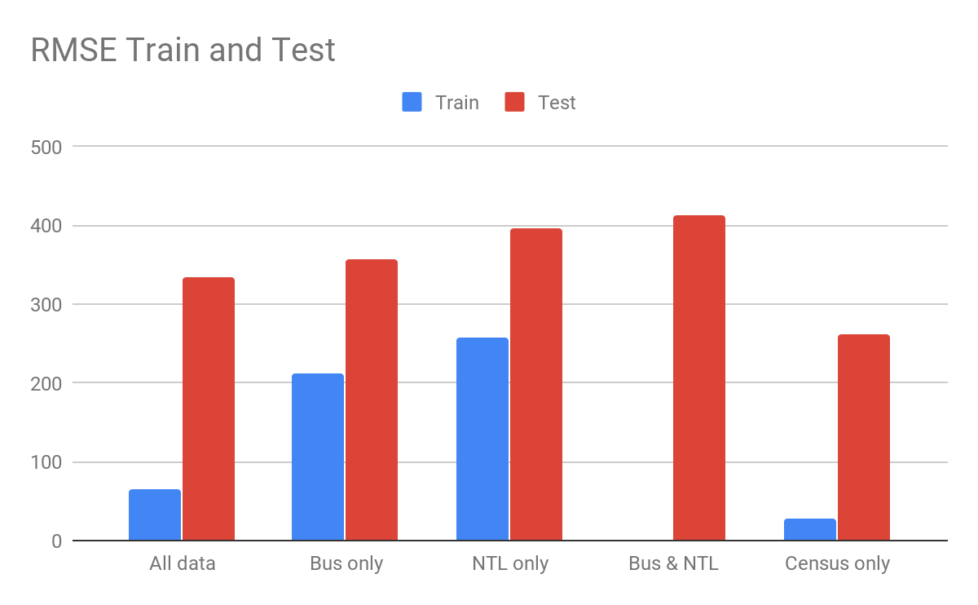
Decision tree modeling - overall - RMSE

Slide 36
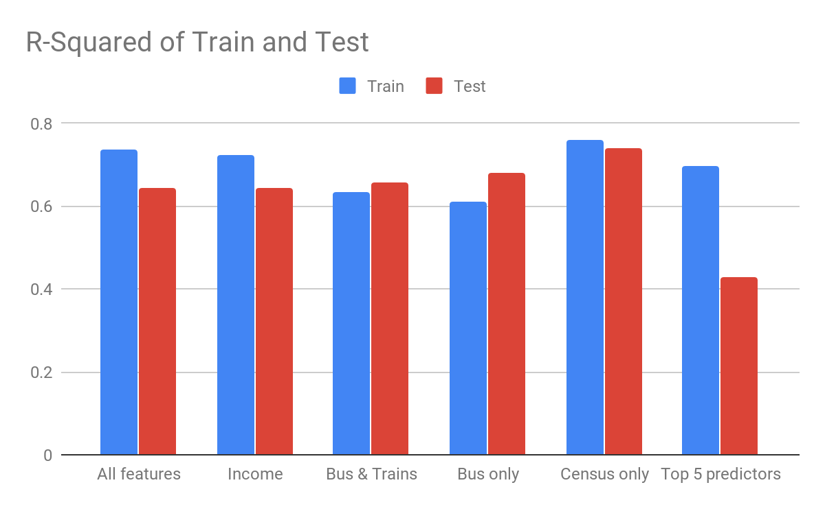
Linear modeling - by dwelling type - R2

Slide 37
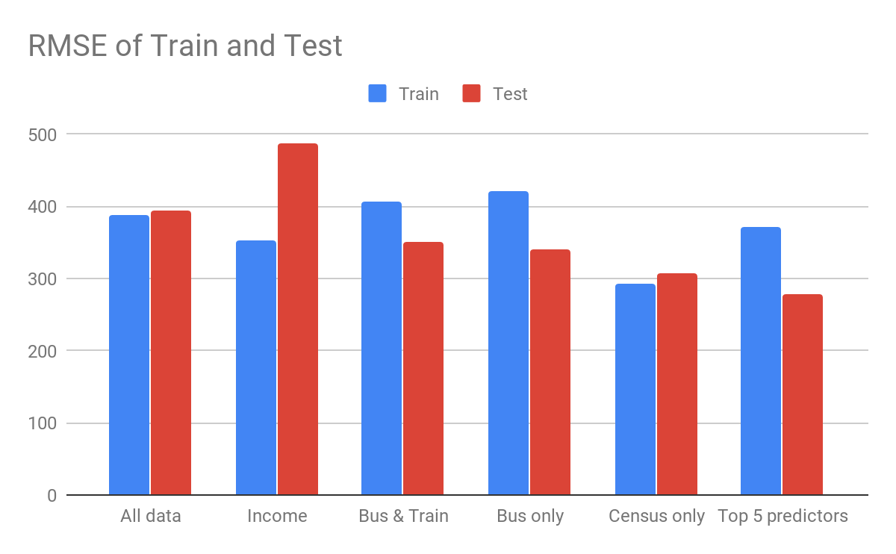
Linear modeling - by dwelling type - RMSE

Slide 38
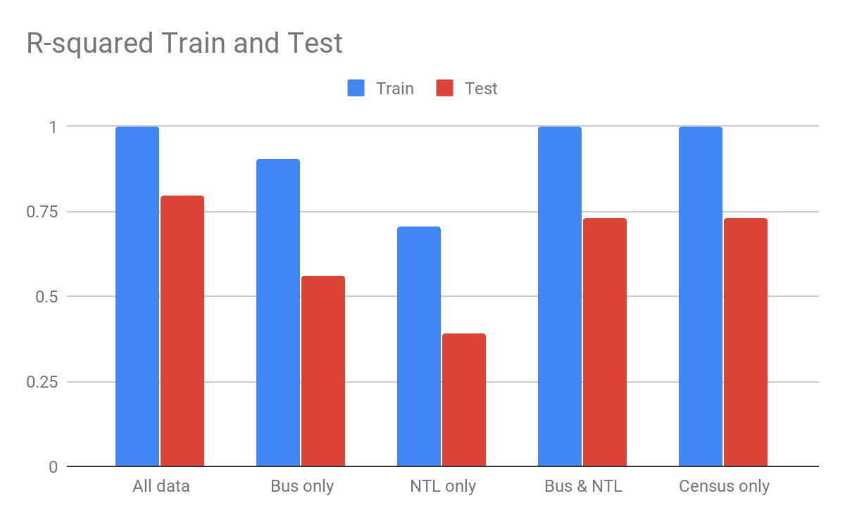
Decision tree modeling - by dwelling type - R2

Slide 39
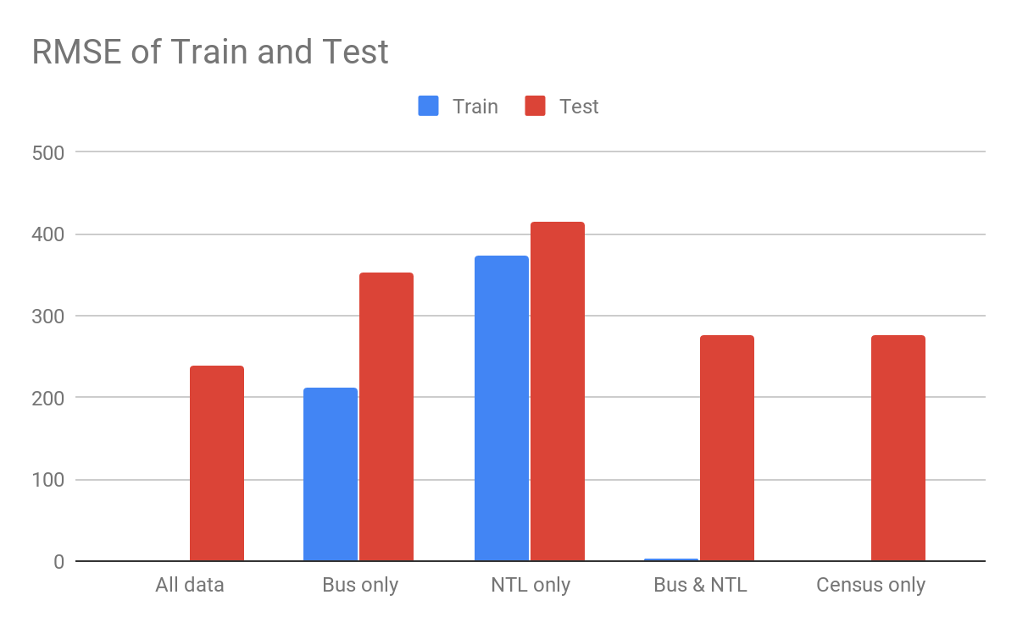
Decision tree modeling - by dwelling type - RMSE

Slide 40
Sales analysis conclusion
The most of the important predictors for House sales come from the transportation, income and census data
Decision tree models also show reasonable R2 values while RMSE doesn’t show similar for trained data and test data. The Trained data show a lower RMSE where as Test data show high RMSE. This could be because the model would have been overfitted.

Slide 41
Conclusion

Slide 42
Final thoughts
Census variables are the best predictors among the three sets of predictors in both the linear regression and decision tree regression.
Degree of accessibility within the LGA also affects the house prices and weekly rent for that area
Nighttime lights variables are not as relevant but its availability could be helpful for model extension
Decision Tree model is not appropriate algorithm as it tends to overfit the data.
Linear regression provided much mot consistent model assessment metrics and gives a very high R2 with census variables

Slide 43
Further extension
Our analysis is based on LGAs of NSW region while the rent and sales data file also includes data for each postcode in NSW. Therefore, this analysis could be further extended to postcode.
Our analysis has proved that Decision Tree Regression is not appropriate model for house sales and rent prediction so other algorithms could be used to compare with Linear Regression.

Slide 44
Thank you.

